Slide 1
Dragon1 Enterprise Architecture Document
www.dragon1.com/resources

Slide 2
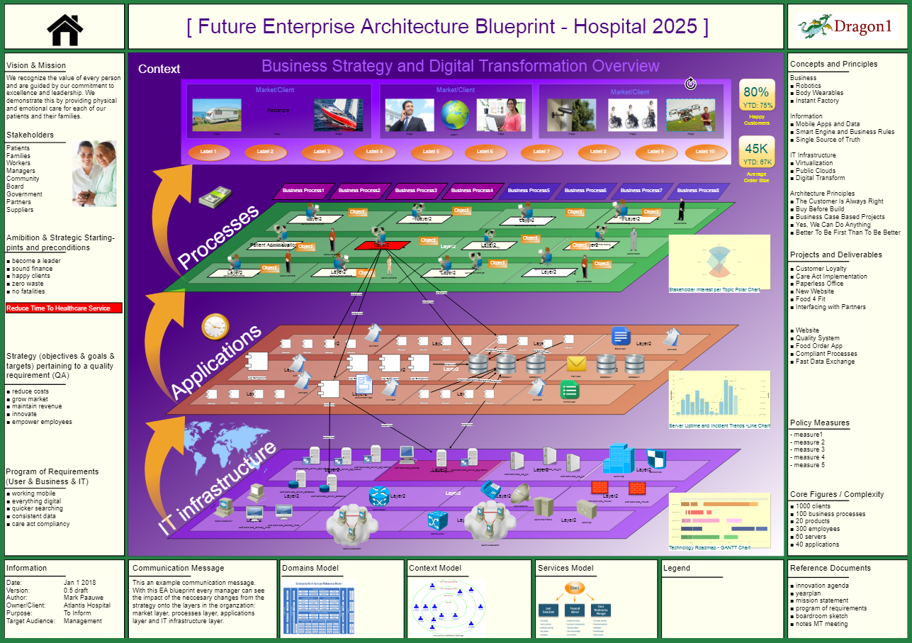
Enterprise Architecture Blueprint

